Slide 1


01/15
Algorithms & Data Structures
Project
MINESWEEPER
https://vinhngph.github.io/Minesweeper/
ITITIU21350 - Nguyễn Phúc Vinh

Slide 2

02/15
Table of
CONTENTS
01
02
03
04
Introduction
Game rules
UML
Game features
05
Demonstration

Slide 3
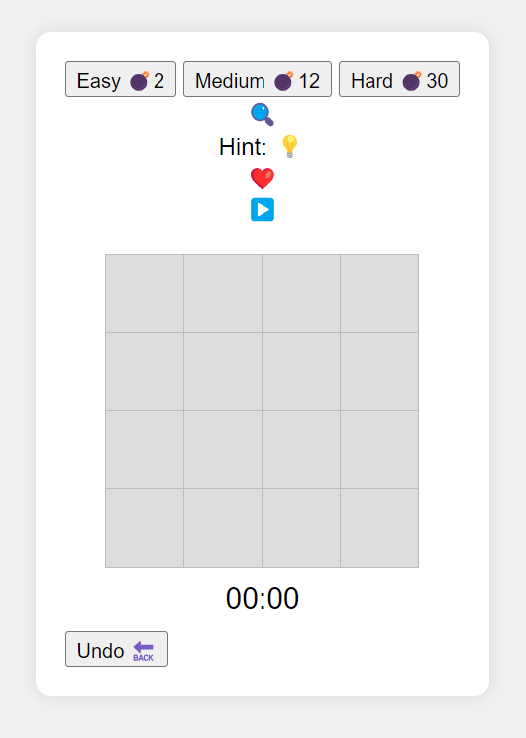
03/15
INTRODUCTION
Javascript
HTML

Slide 4
04/15
GAME RULES
Three levels
Support player: Safe cell, Hint
The remains lives: ❤️
The status: ▶️ or 🔥
Left click to unlock the cell
Right clock to flag/unflag the cell
Record best time
Undo actions

Slide 5
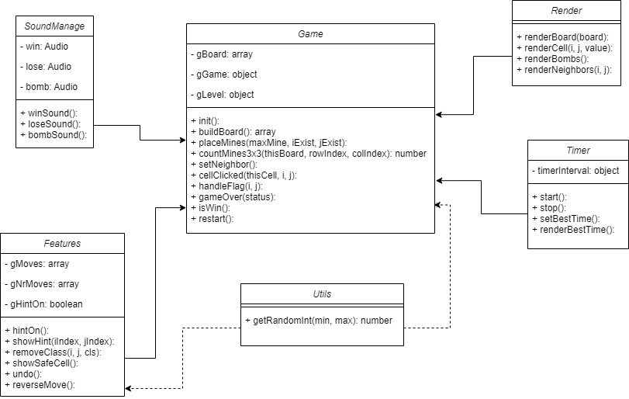
UML
05/15

Slide 6
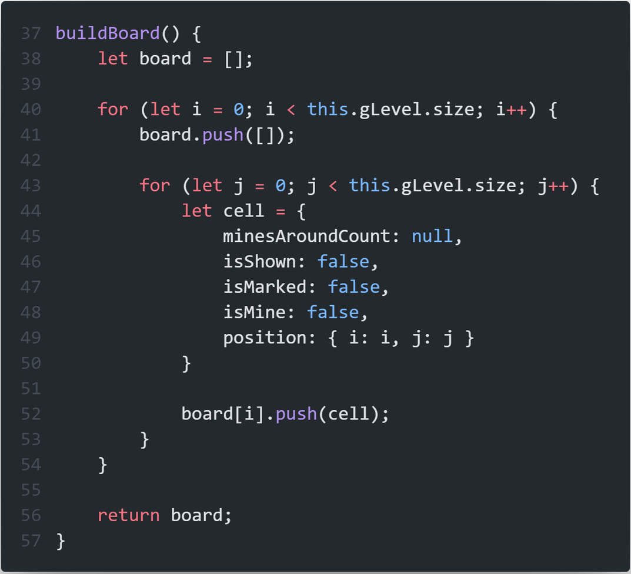
Game board
06/15

Slide 7
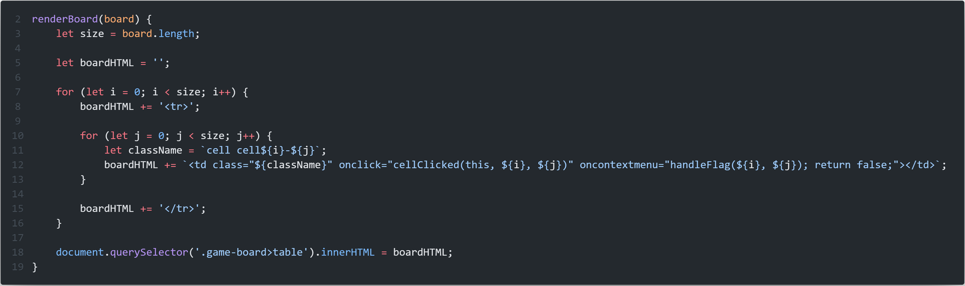
Game board
07/15
O(N^2)

Slide 8
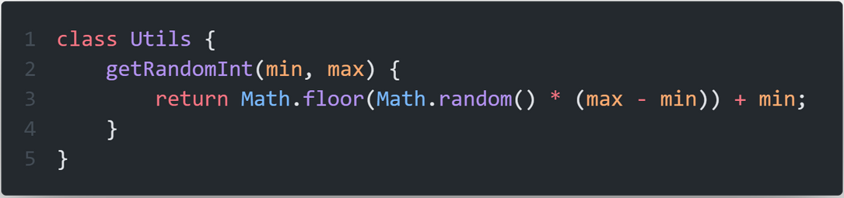
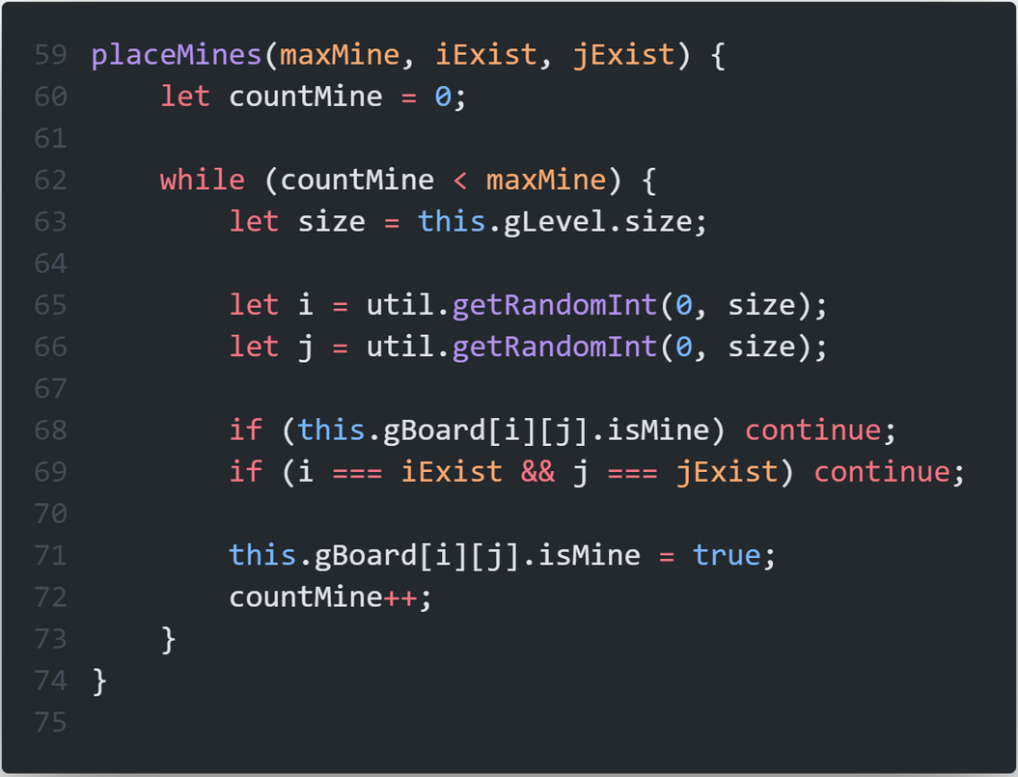
Random mines
08/15

Slide 9
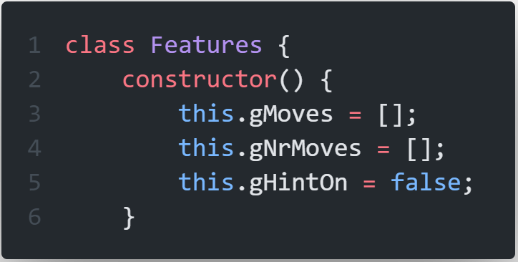
Features class
09/15

Slide 10
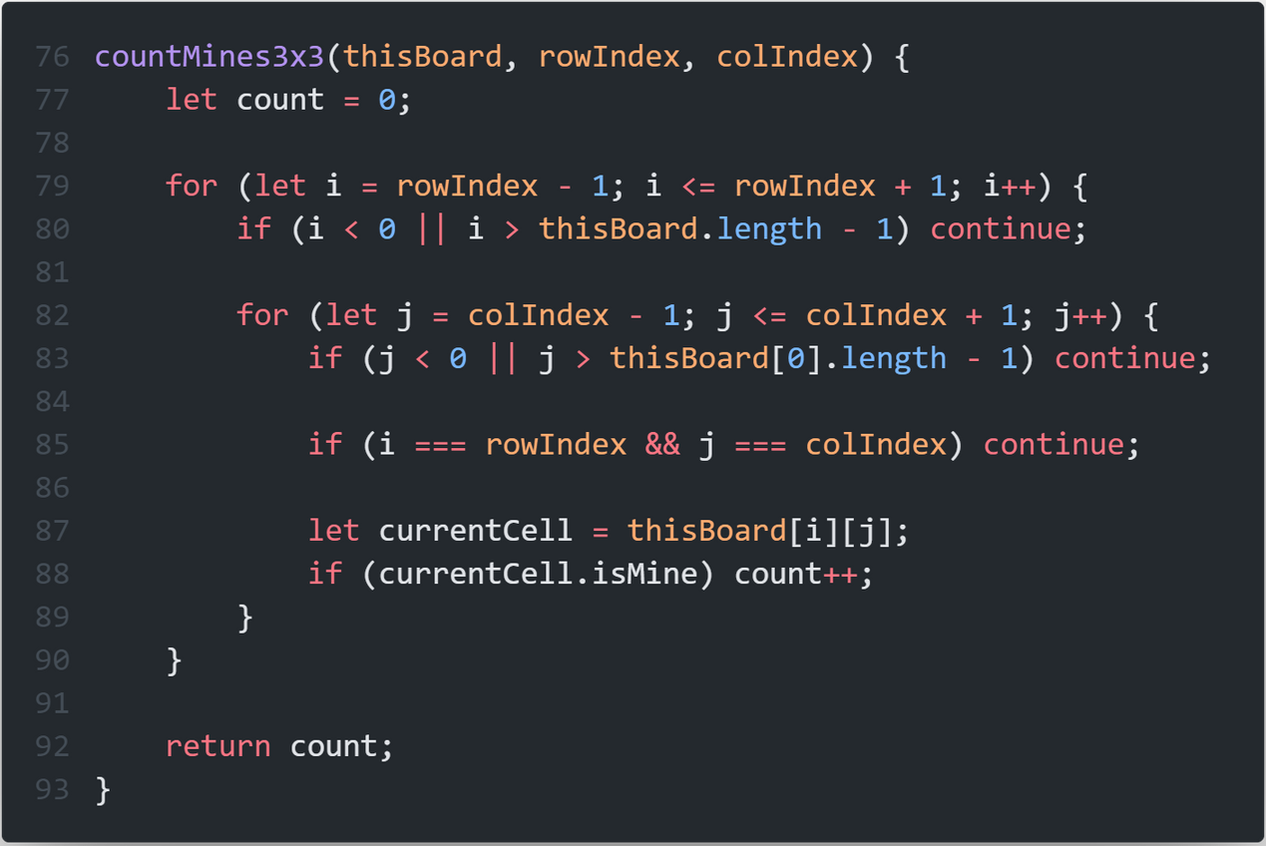
Count 3x3
10/15
O(1)

Slide 11
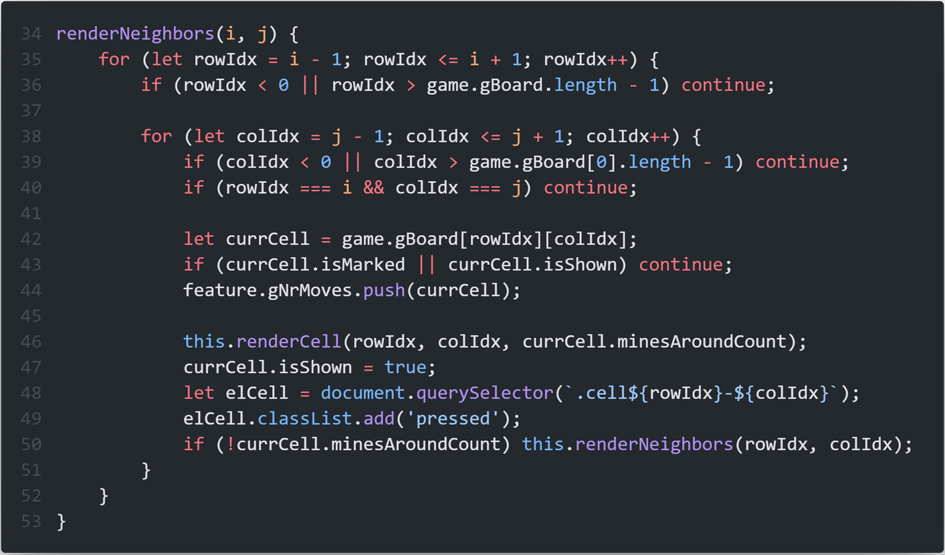
Render neighbors
11/15
O(1) OR O(N^2)

Slide 12
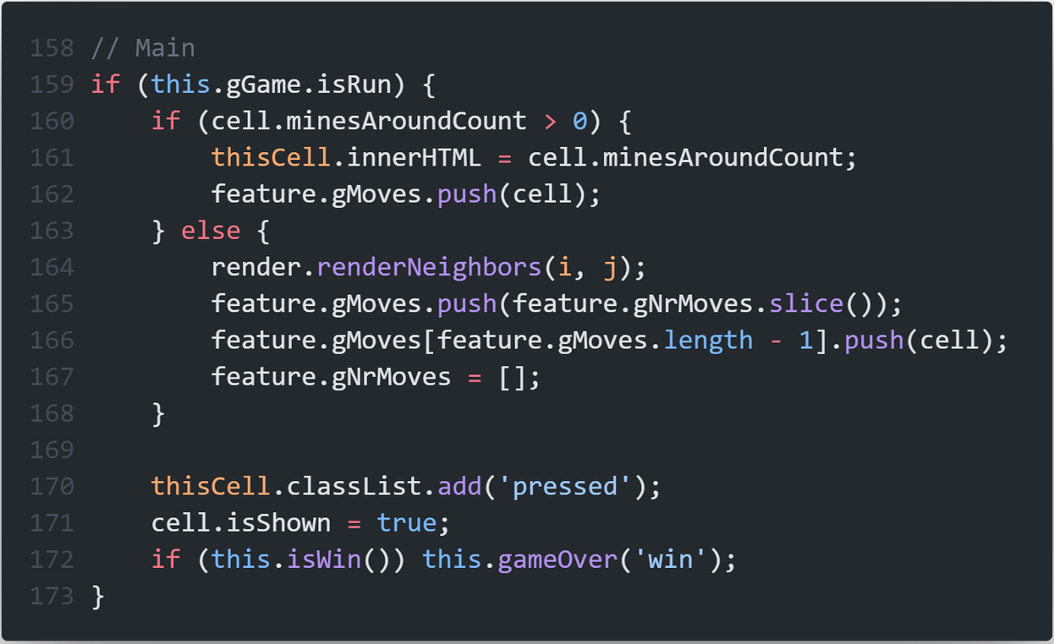
Main feature
12/15

Slide 13
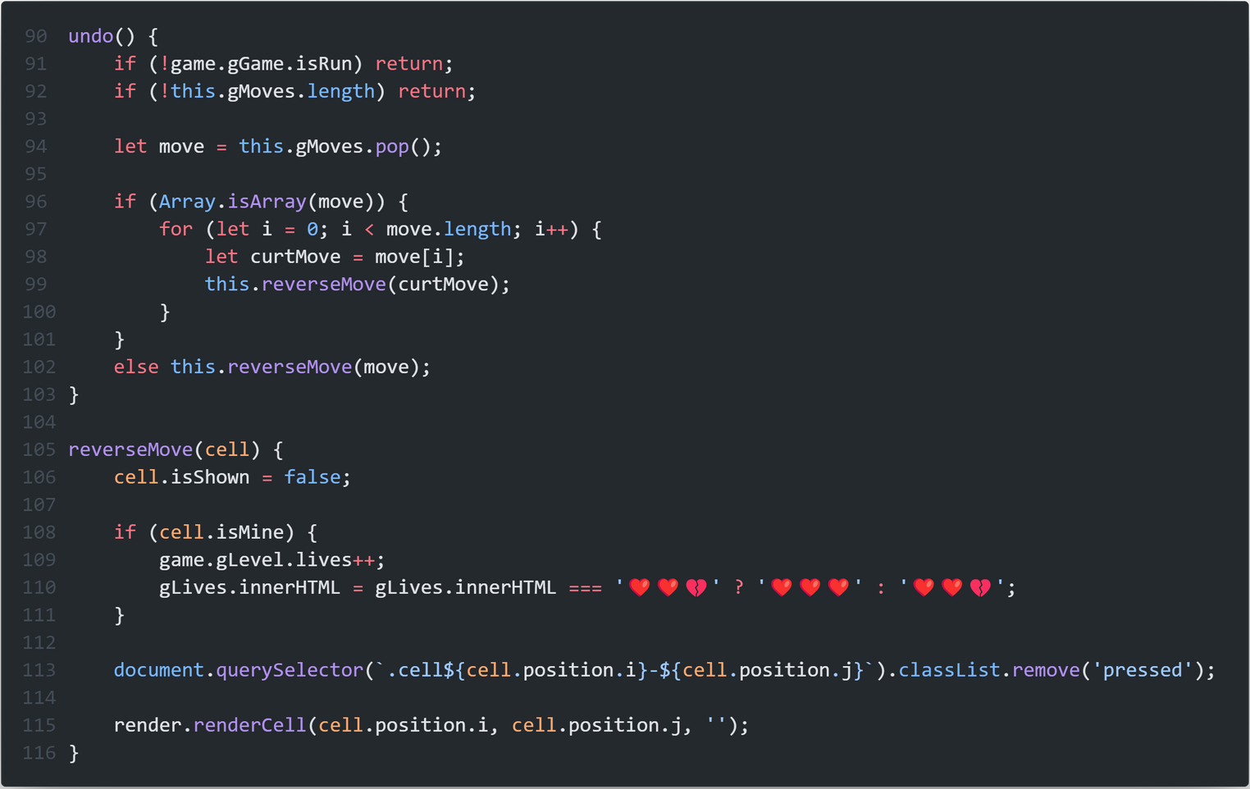
Undo
13/15
O(1) OR O(N)

Slide 14
14/15
Demonstration

Slide 15
15/15
Thank you for listening

